Slide 1
Chapter 5
List
General Linear Lists
Objectives
Upon completion you will be able to:
Explain the design, use, and operation of a linear list
Implement a linear list using a linked list structure
Understand the operation of the linear list ADT
Write application programs using the linear list ADT
Design and implement different link-list structures

Slide 2
General linear lists
A general linear list is a list in which operations can be done anywhere in the list.
For simplicity, we refer to general linear lists as lists.

Slide 3
5-1 Basic Operations
We begin with a discussion of the basic list operations. Each operation is developed using before and after figures to show the changes.
Insertion
Deletion
Retrieval
Traversal

Slide 4
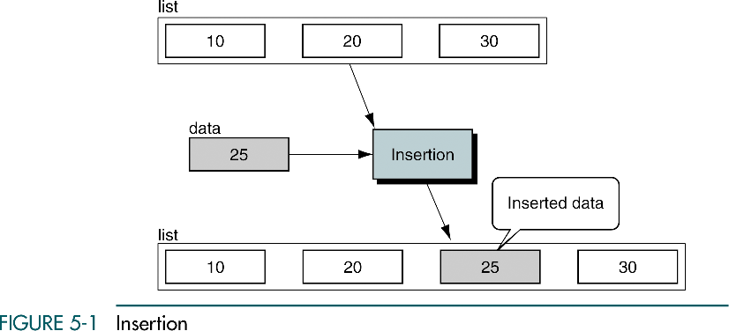
Insertion is used to add a new element to the list

Slide 5
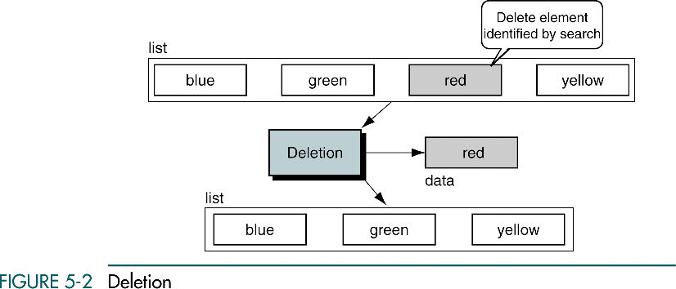
Deletion is used to remove an element from the list.

Slide 6
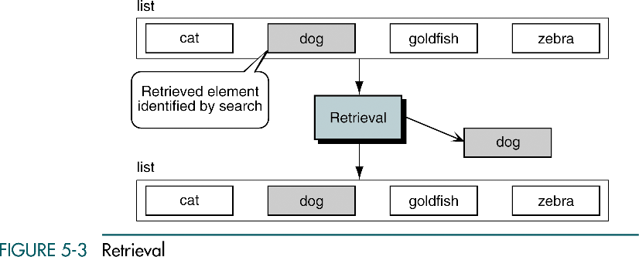
Retrieval is used to get the information related to an element
without changing the structure of the list.

Slide 7
Traversal
List traversal processes each element in a list in sequence.

Slide 8
5-2 Implementation
We begin with a discussion of the data structure required to support a list. We then develop the 10 basic algorithms required to build and use a list. In developing the insertion and deletion algorithms, we use extensive examples to demonstrate the analytical steps used in developing algorithms.
Data Structure
Algorithms

Slide 9
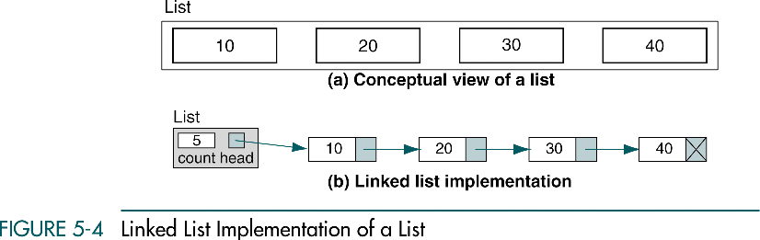

Slide 10
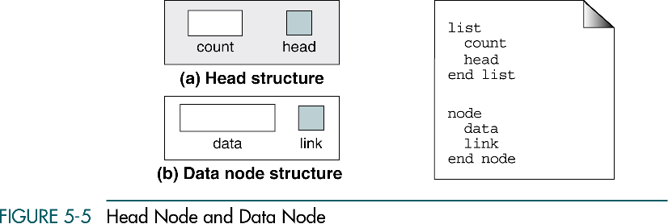

Slide 11
Algorithms
Create list
Insert node
Delete node
List search
Retrieve node
Empty list
Full list
List count
Traverse list
Destroy list

Slide 12
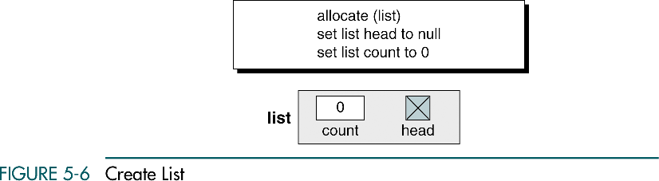

Slide 13
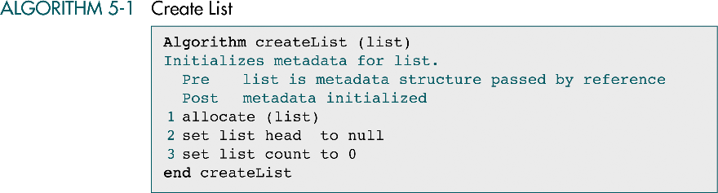

Slide 14
Insert node
Only its logical predecessor is needed.
There are three steps to the insertion:
  Allocate memory for the new node and move data to the node.
  Point the new node to its successor.
  Point the new node’s predecessor to the new node.

Slide 15
Insert node
Insert into empty list
Insert at beginning
Insert in middle
Insert at end

Slide 16
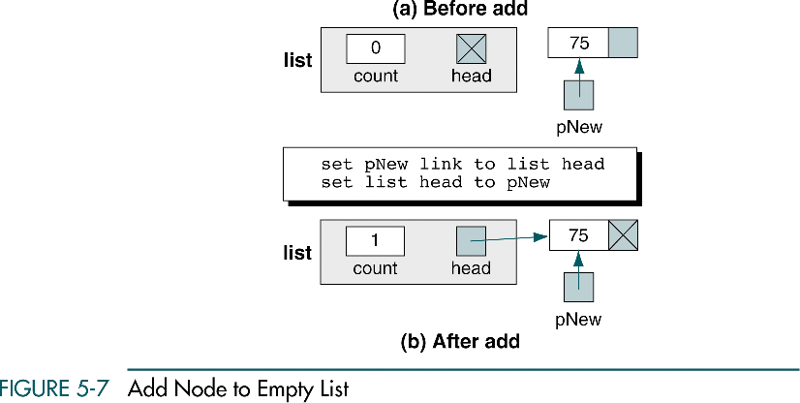

Slide 17
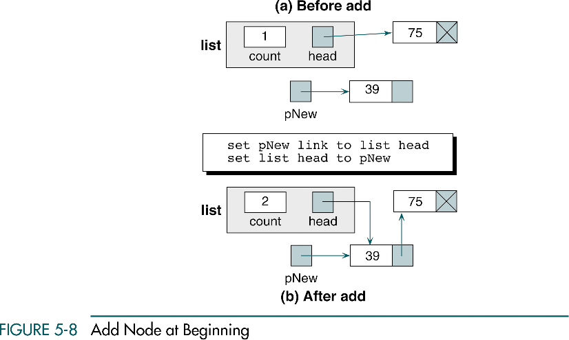

Slide 18
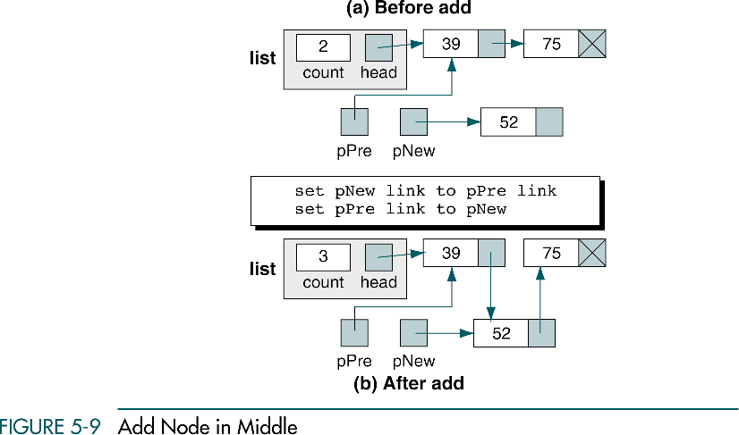

Slide 19
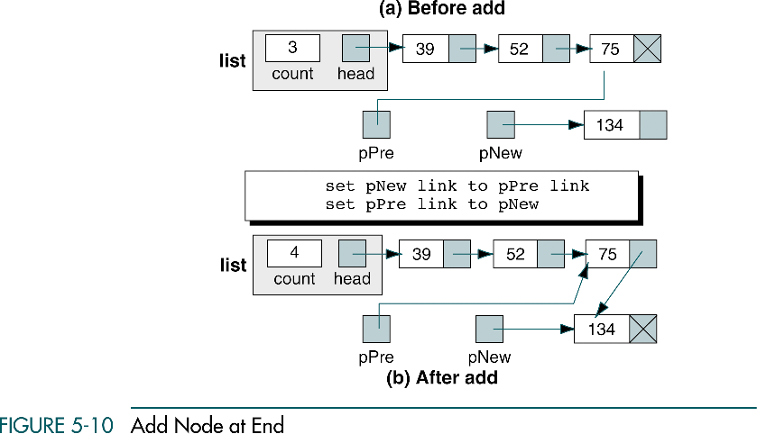

Slide 20
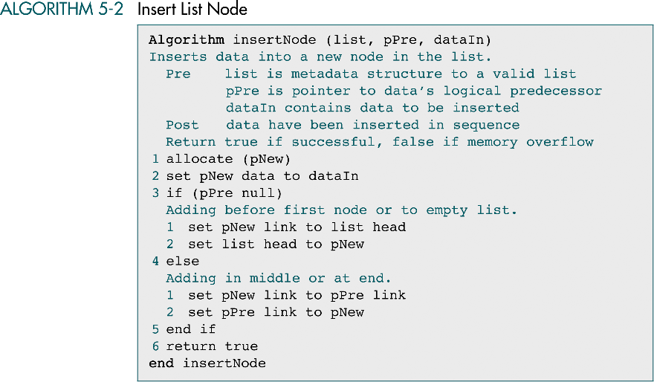

Slide 21
Delete node
Delete first node
Delete general case

Slide 22
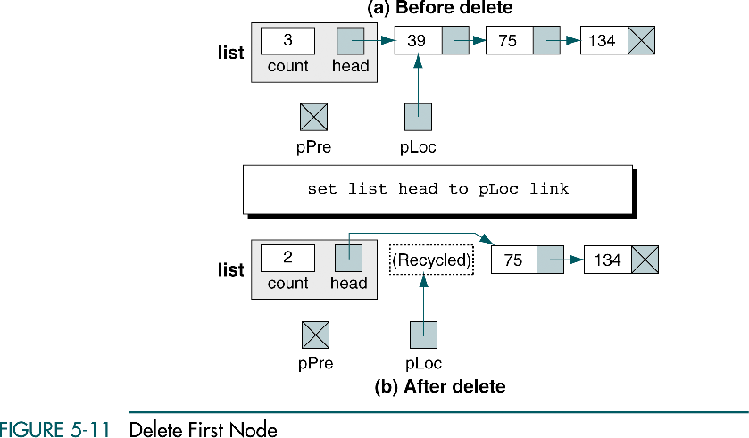

Slide 23
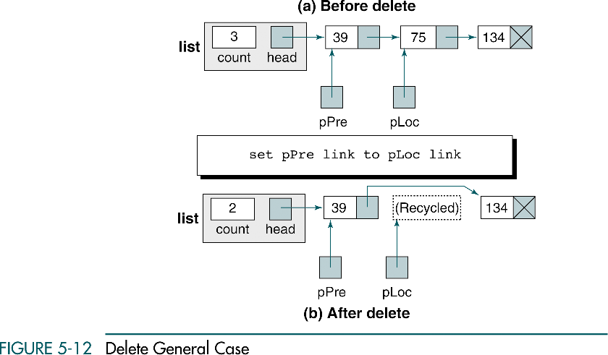

Slide 24
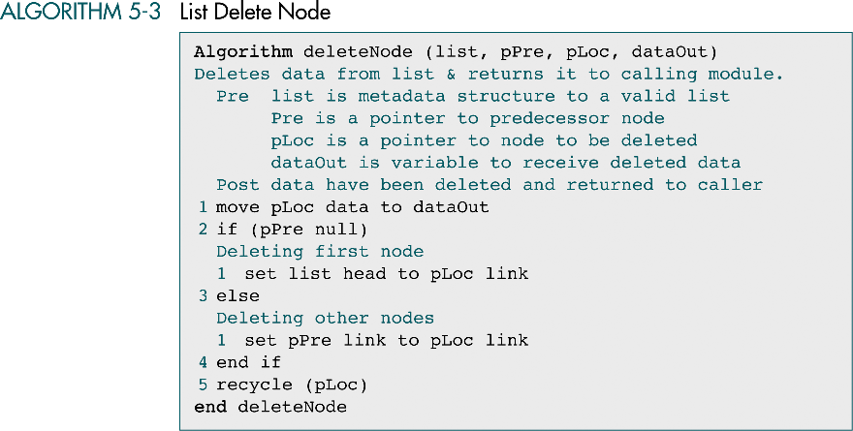

Slide 25
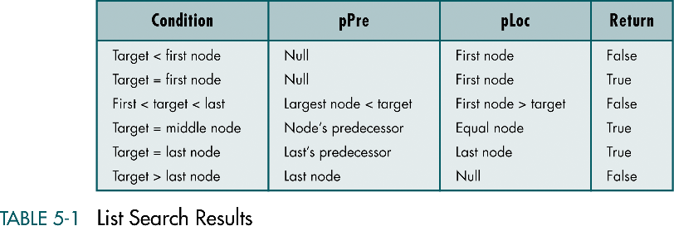

Slide 26
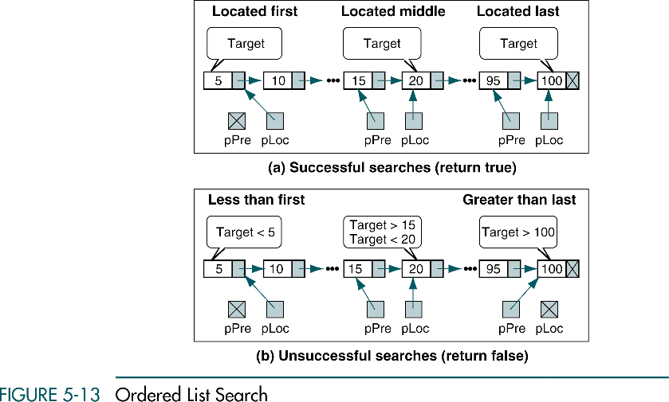

Slide 27
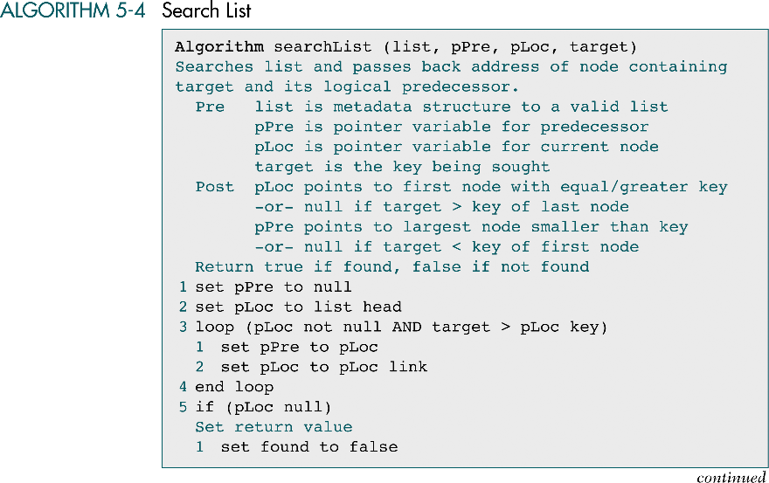

Slide 28
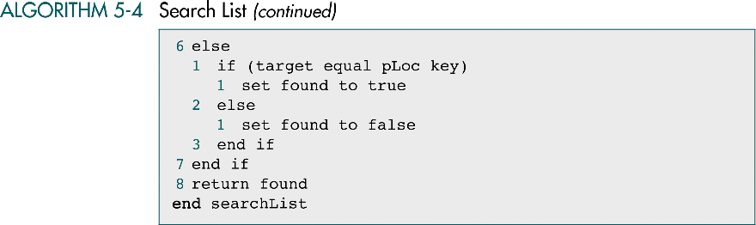

Slide 29
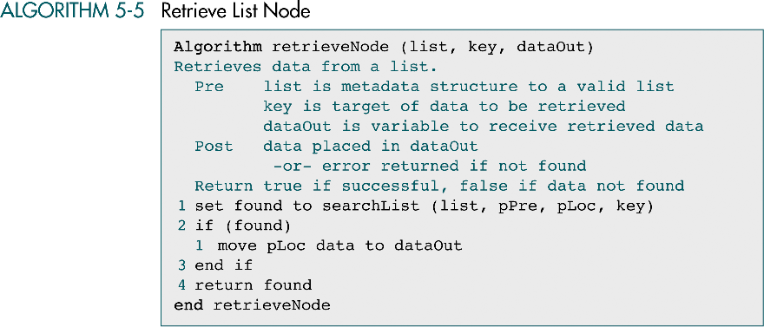

Slide 30
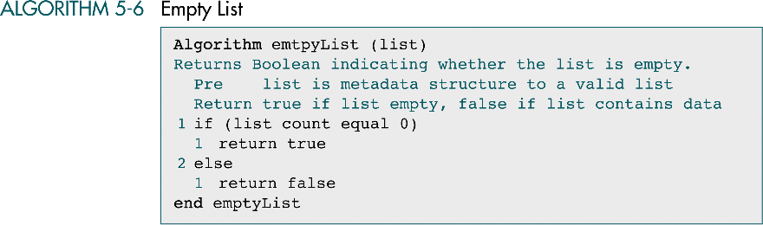

Slide 31
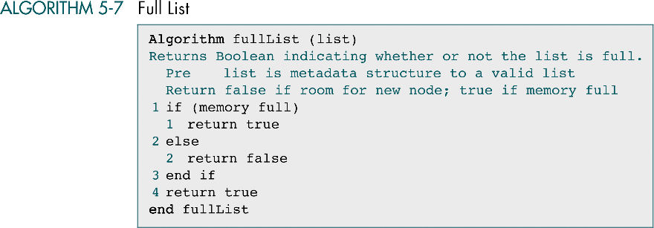

Slide 32
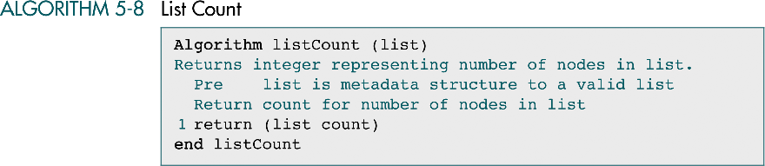

Slide 33
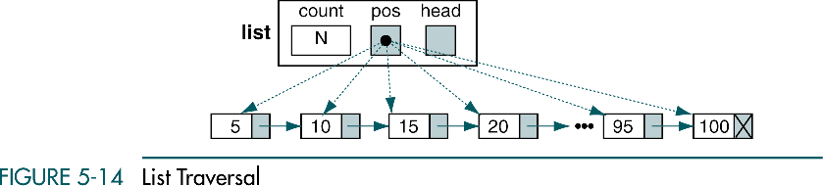

Slide 34
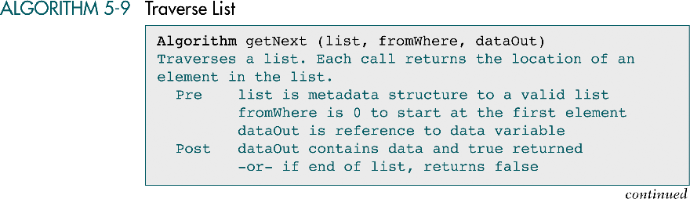

Slide 35
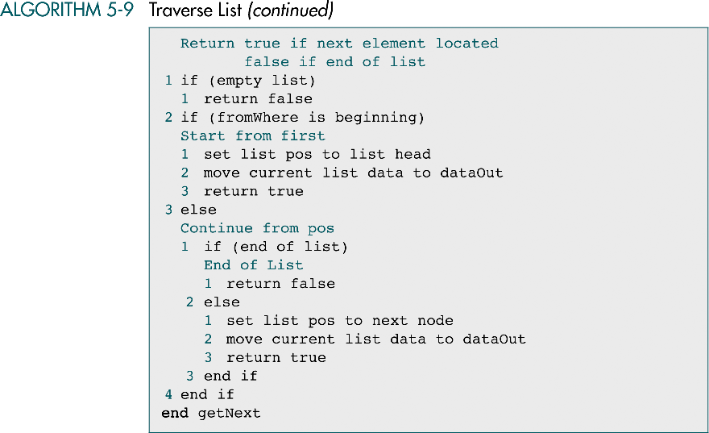

Slide 36
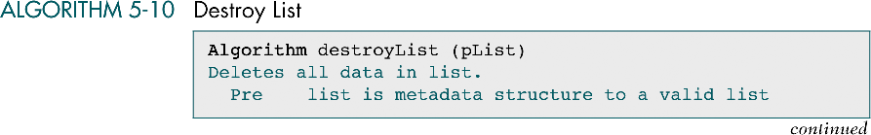

Slide 37
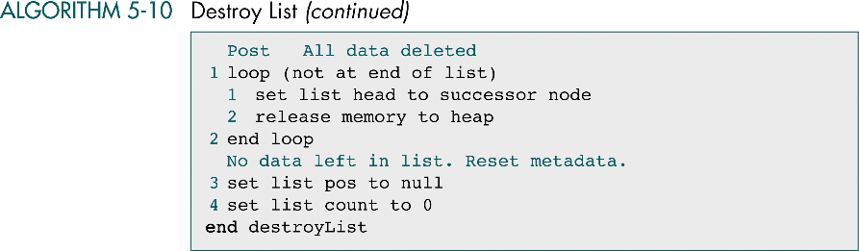

Slide 38
5-3 List ADT
We begin with an extensive discussion of the list data structure and the compare function that is required to maintain the list in sequence. We then develop the C functions required to implement the ADT.

Slide 39
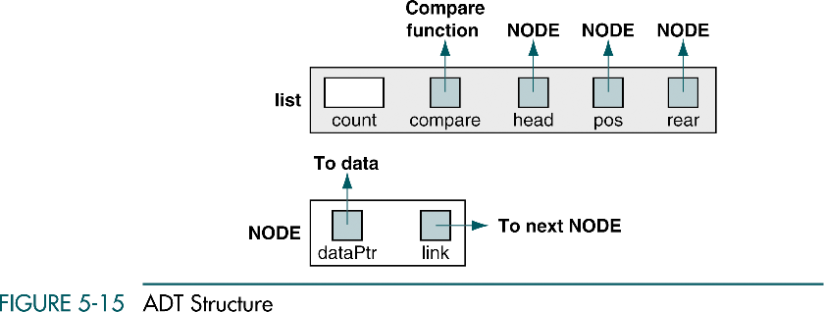

Slide 40
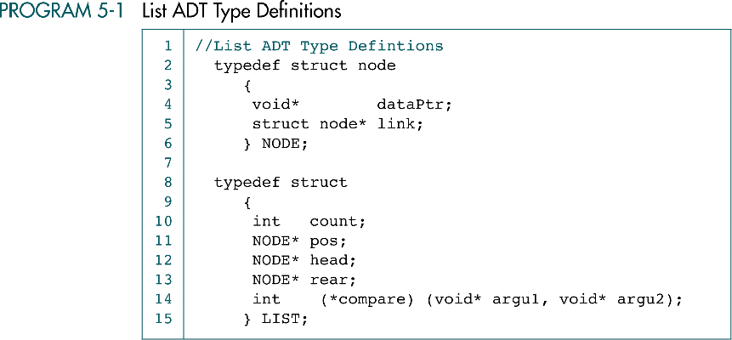

Slide 41
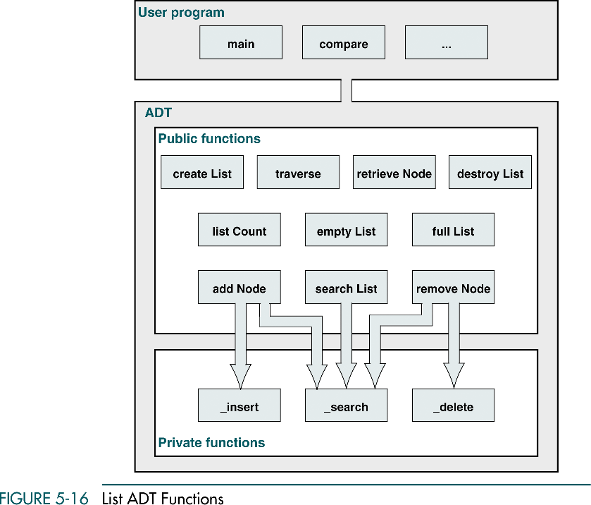

Slide 42
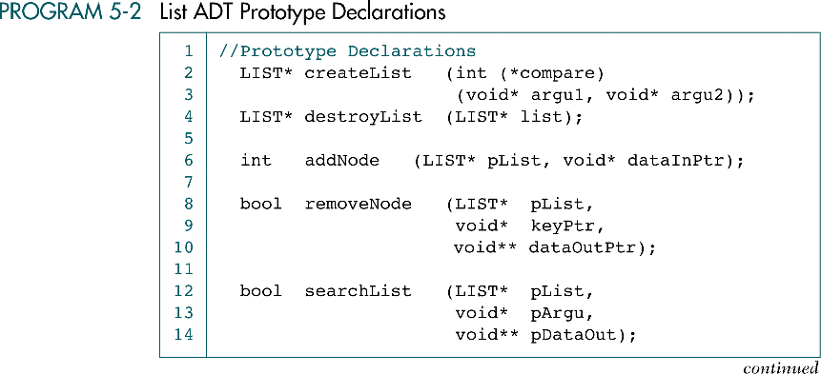

Slide 43
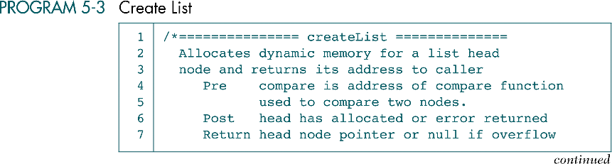

Slide 44
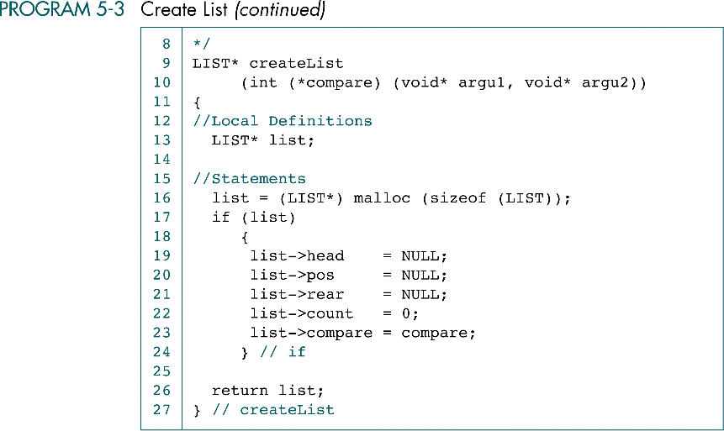

Slide 45
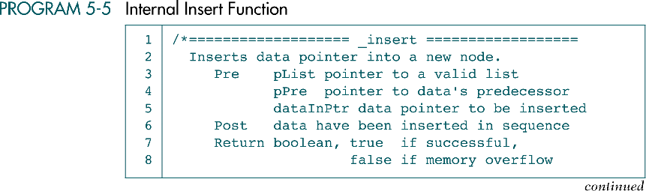
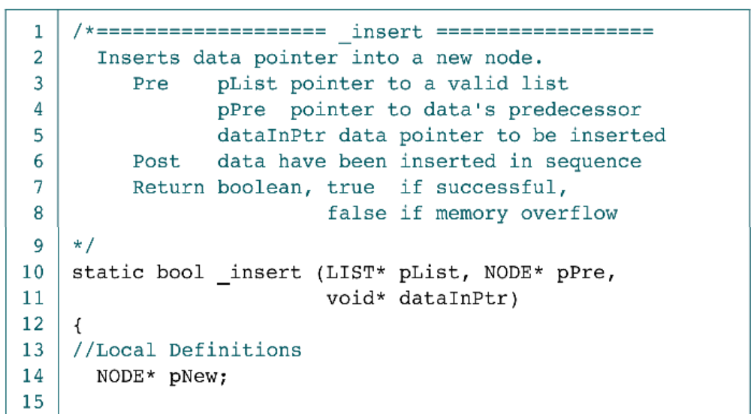

Slide 46
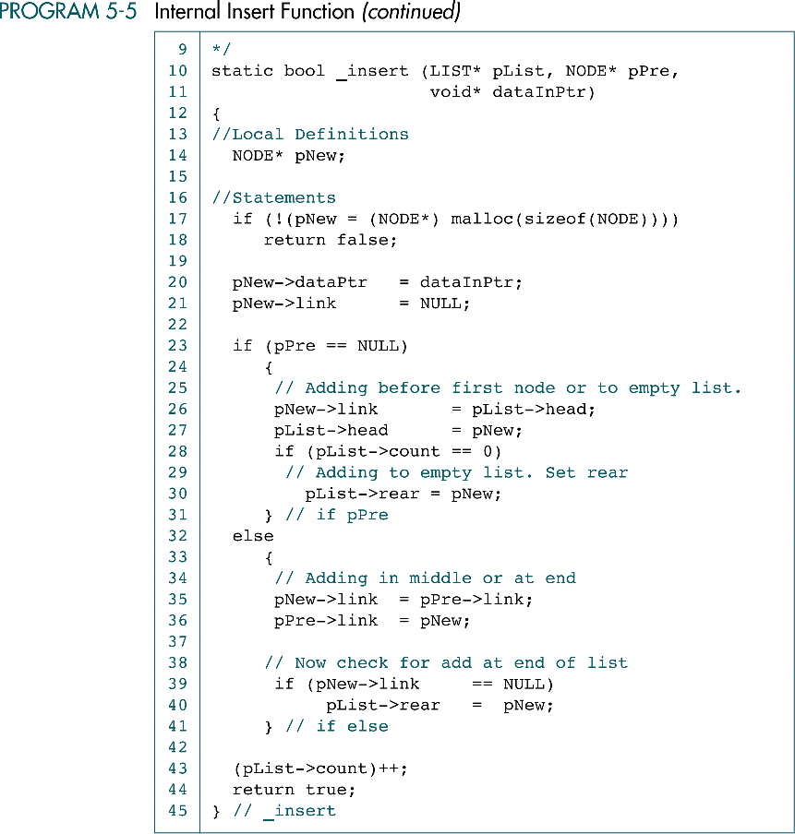

Slide 48
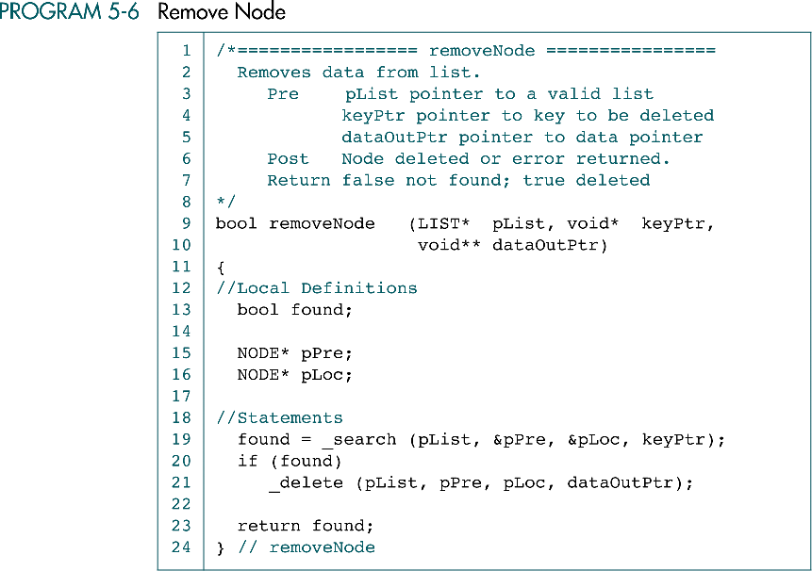

Slide 49
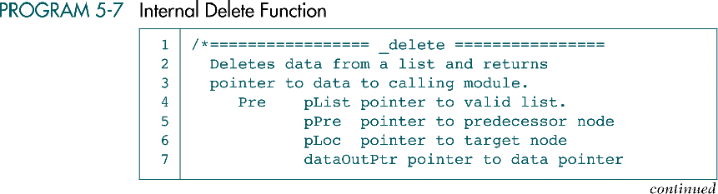

Slide 50
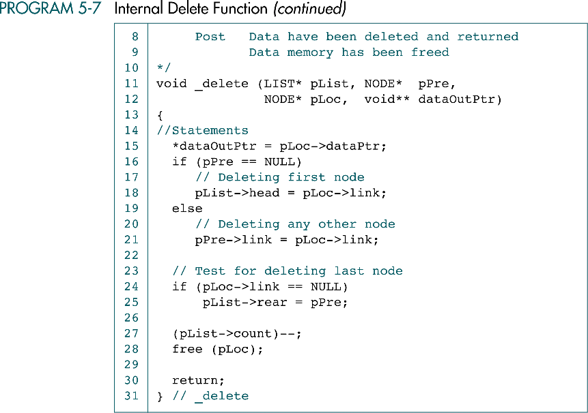

Slide 51
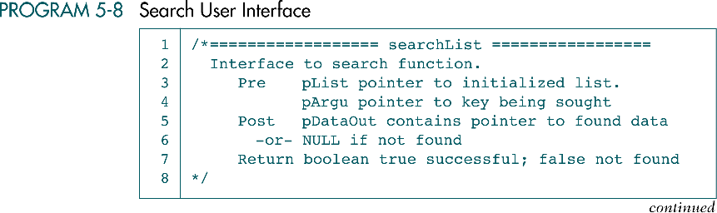

Slide 52
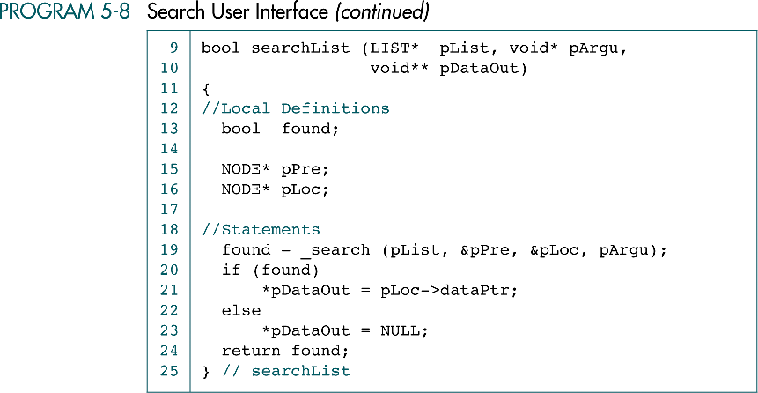

Slide 53
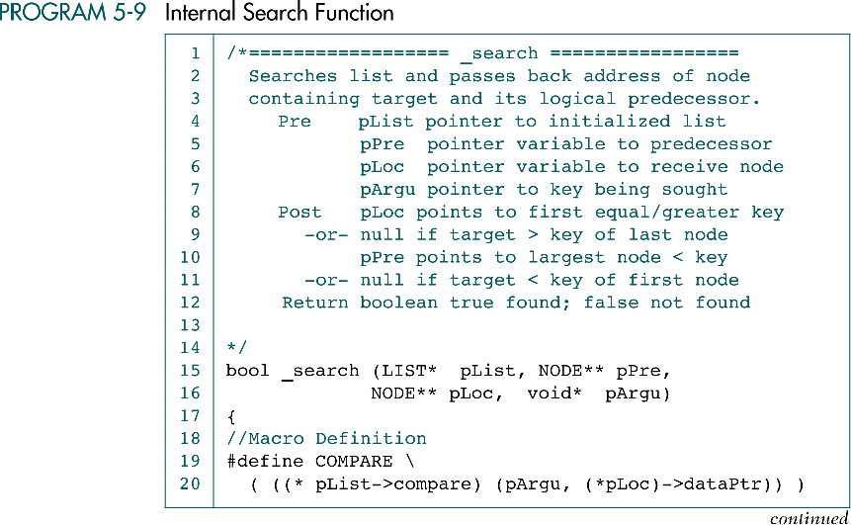

Slide 54
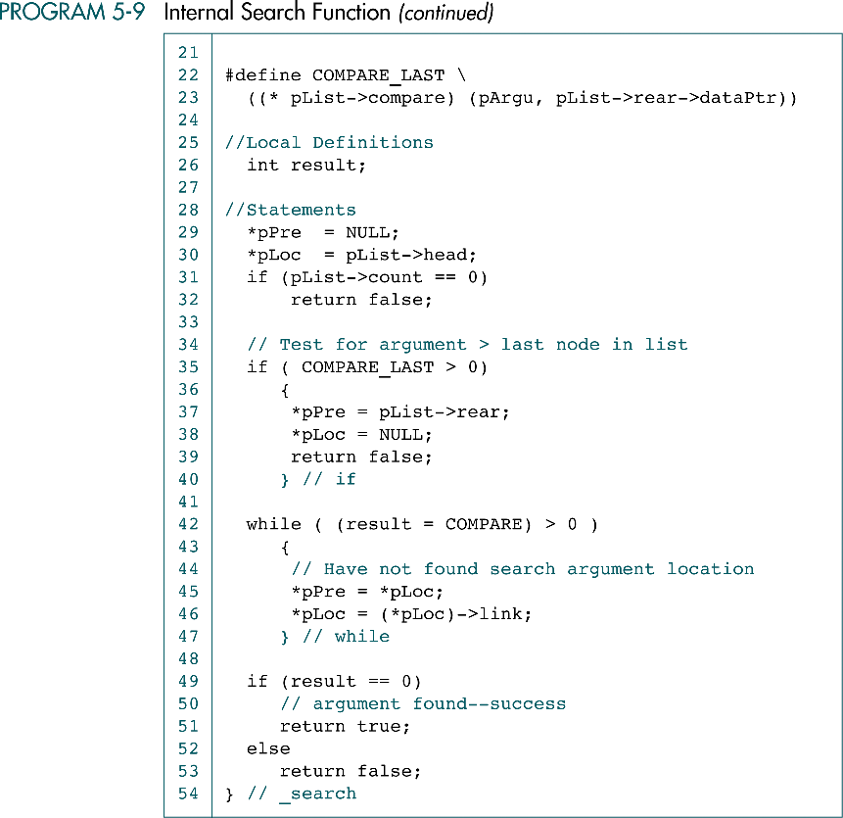

Slide 56
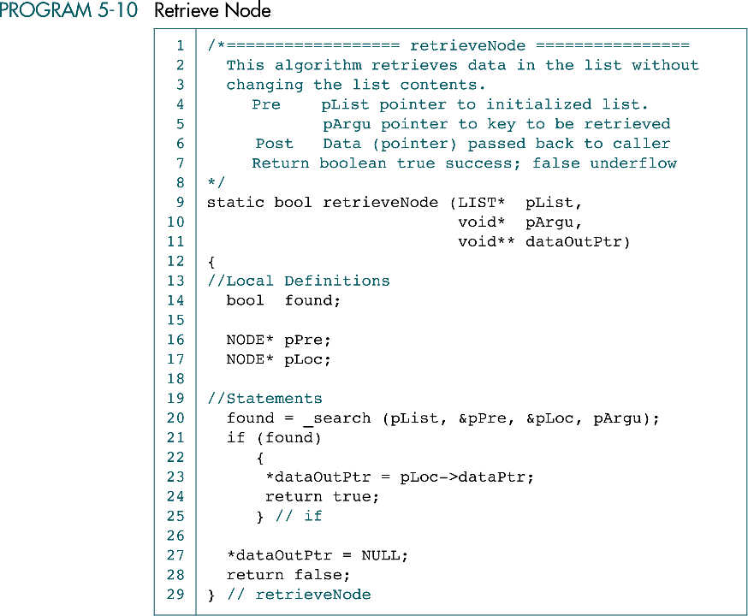

Slide 57
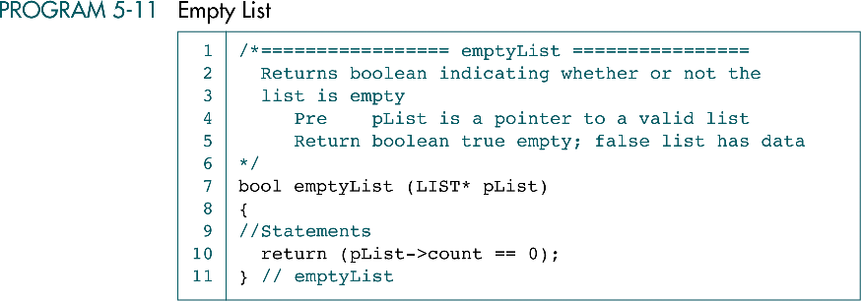

Slide 58
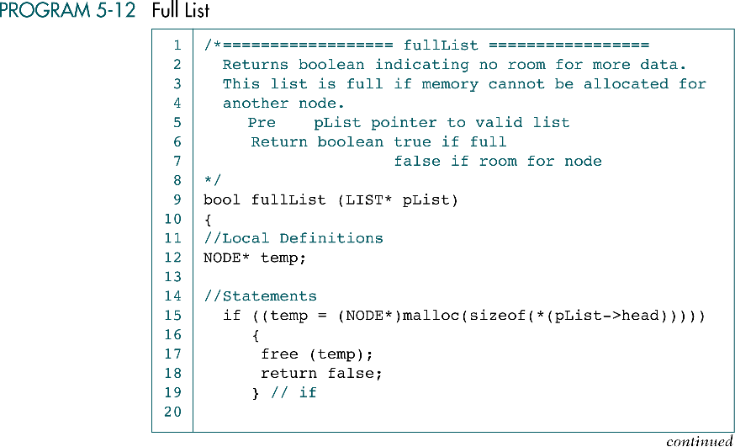

Slide 59


Slide 60
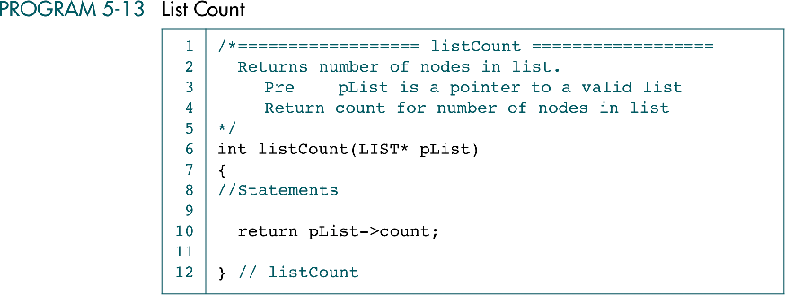

Slide 61
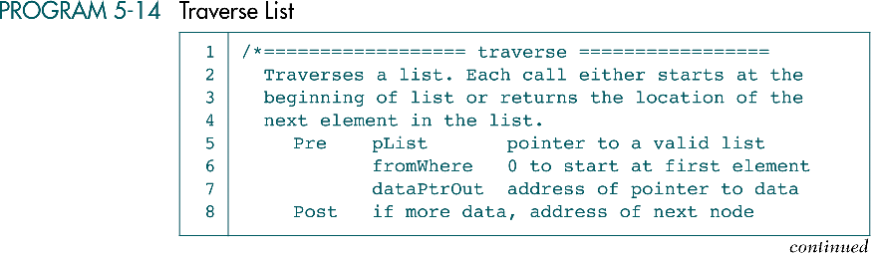
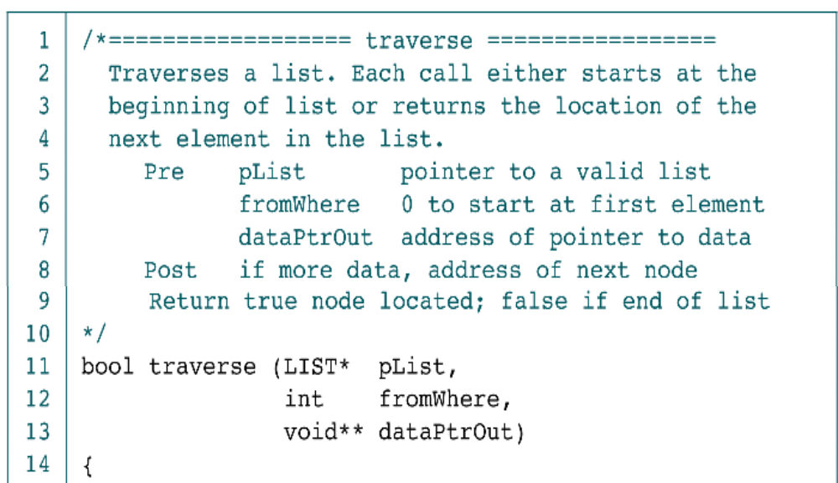

Slide 62


Slide 64


Slide 66
5-4 Application
To demonstrate how easily we can implement a list once we have an abstract data type, we implement a list of award-winning pictures and their directors. We then develop eight functions to implement the application. We conclude with a discussion of the basic steps required to test a list implementation.
Data Structure
Application Functions
Testing Insert and Delete Logic

Slide 67


Slide 68


Slide 69


Slide 70
(continued)

Slide 71


Slide 72


Slide 73


Slide 74


Slide 75


Slide 77


Slide 78


Slide 79


Slide 80


Slide 81


Slide 82



Slide 83


Slide 84


Slide 85


Slide 86


Slide 87


Slide 88


Slide 89
(continued)

Slide 90


Slide 91


Slide 92


Slide 93


